Slide 1
Government Polytechnic Jalgaon
Emerging Trends In Electronics
22636
Akole K P

Slide 2
Unit– I
Advance Processors
UO1a.1 Explain processor selection criteria.

Slide 3
UO 1
Describe the given advancement in the processor architecture.

Slide 4

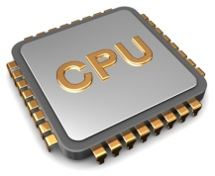

Learning Objective
UO1a.1
Explain processor selection criteria.
Try answering these questions
Q1. Have you heard about Processor/ Controller?

Slide 5
Content
Introduction
Processor(computing)
Processor selection criteria

Slide 6
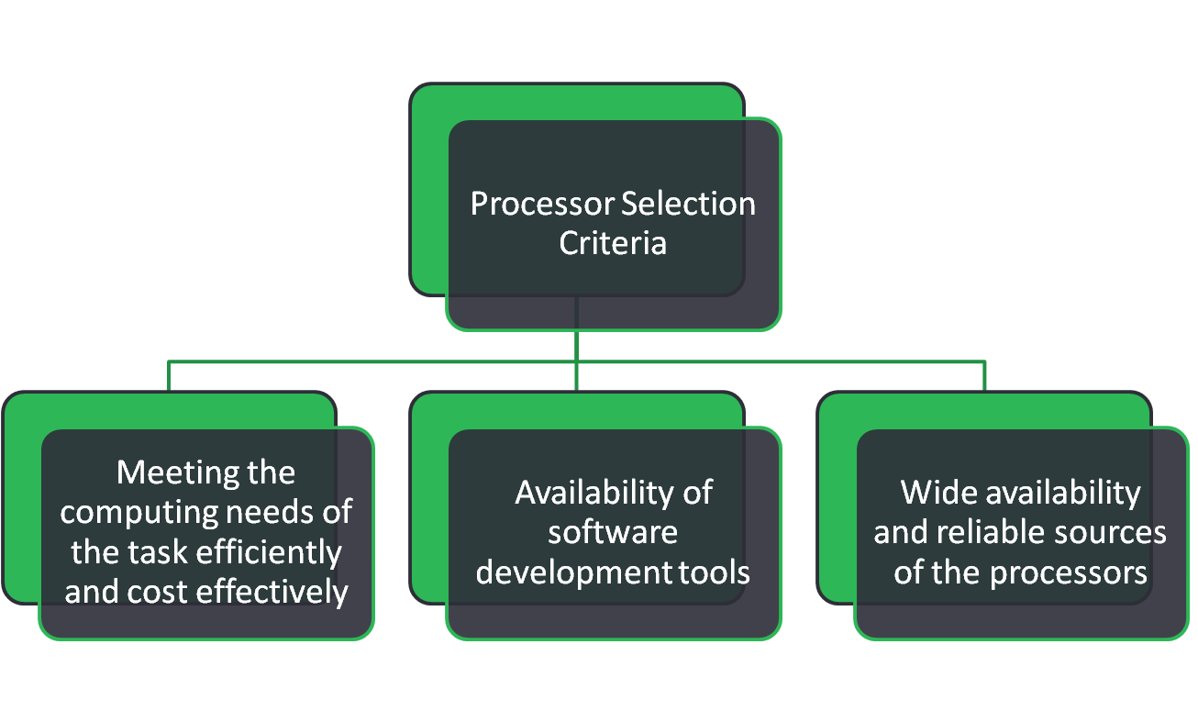
Concept Map

Slide 7
Introduction
Processors have undergone a tremendous evolution throughout their history.
The first microprocessor was introduced by Intel under the name of Intel 4004 in 1971.
The complexity of an integrated circuit is bounded by physical limitations on the number of transistors that can be put onto one chip.
Advancing technology makes more complex and powerful chips feasible to manufacture.

Slide 8
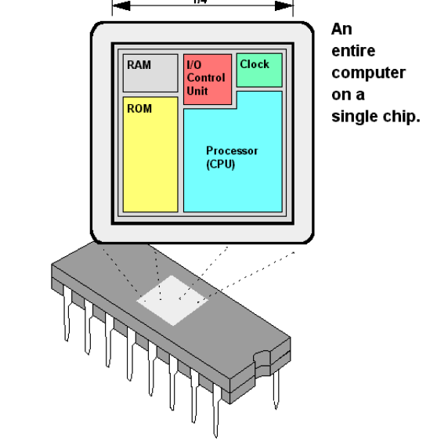
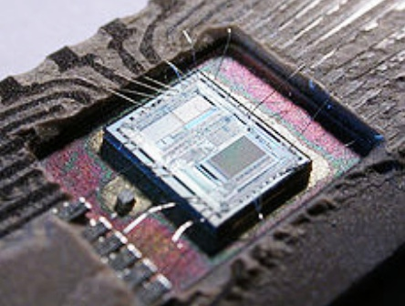

Processor (Computing)
Processor (Computing): In computing, a processor or processing unit is a digital circuit which performs operations on some external data source, usually memory or some other data stream.
Microprocessor can be implemented on a single metal–oxide–semiconductor integrated circuit.

Slide 9
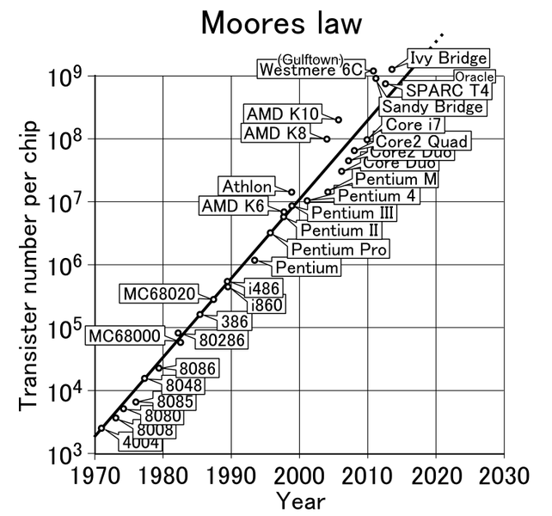
Moore's law
Moore's law is the observation that the number of transistors in a dense integrated circuit (IC) doubles about every two years.

Slide 10
Processor Selection Criteria
The first and foremost criterion in choosing a processor/ controller is that it must meet the task at efficiently and cost effectively.
Following considerations need to be factored during processor selection for a Digital Systems.
Performance Considerations
Power considerations
Memory
Peripheral Set
Operating Voltage
Specialized Processing Units
Price

Slide 11
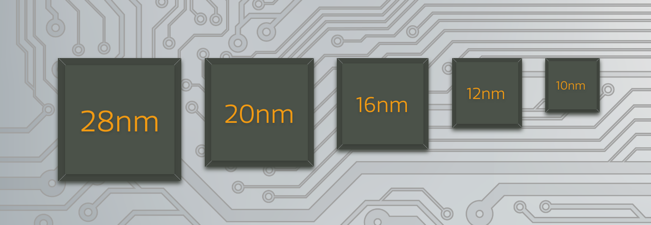
Processor Selection Criteria
Performance: The performance speed of a processor is dependent on its architecture and its silicon design.
Clock frequency
Standard notation. MIPS (Million Instructions Per Second) or MIPS/MHz
Dhrystones and latest EEMBC’s CoreMark. CoreMark is one of the best ways to compare the performance of various processors.
Processor architectures with support for extra instruction can help improving performance for specific applications. For example, SIMD (Single Instruction/Multiple Data) set and Jazelle – Java acceleration can help in improving multimedia and JVM execution speeds.

Slide 12
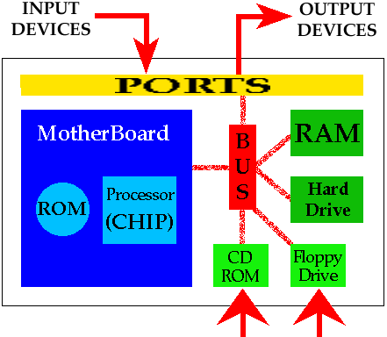
Processor Selection Criteria
Power consumption: Increasing the logic density and clock speed has adverse impact on power requirement of the processor.
Memory: The amount of RAM and ROM on chip.
Internal memory is typically the most cost effective memory type, but it is also the least flexible.
Peripheral set: The number of I/O pins and the timer on the chip. Necessary peripherals provided on chip in SoC’s for effective data communication using DMA.

Slide 13
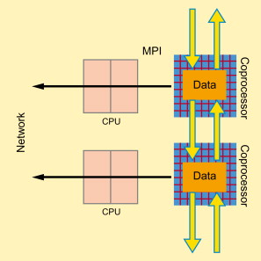
Processor Selection Criteria
Specialized Processing Units: Co-processors execute the instructions fetched by the primary processor thereby reducing the load on the primary.
Floating Point Co-processor
Graphic Processing Unit (GPU)
Digital Signal Processor

Slide 14
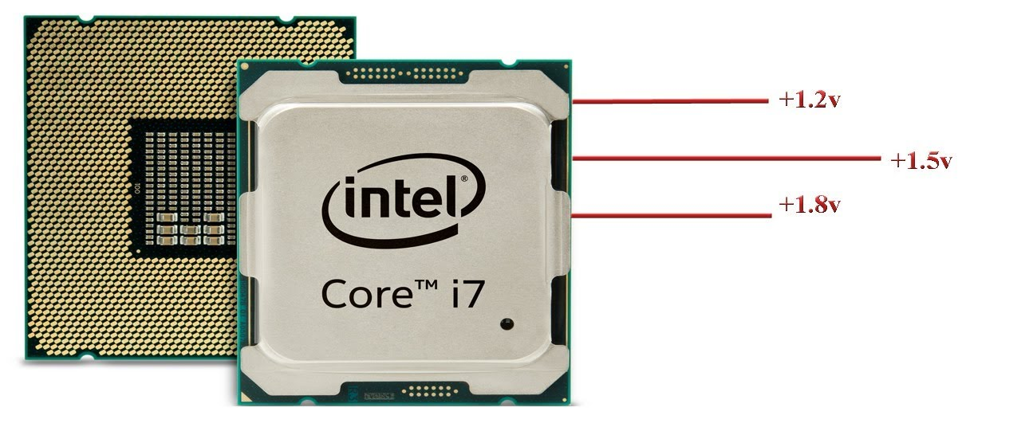
Processor Selection Criteria
Operating voltage: Each and every processor will have its own operating voltage condition.
While higher end processors typically operate with 2 to 5 voltages including 1.8V for Cores/Analogue domains, 3.3V for IO lines
Cost per unit: This is important in terms of the final cost of the product in which a microprocessor is used.

Slide 15

Processor Selection Criteria
The second criterion in choosing a processor is how easy it is to develop products around it.
Key considerations include the availability of an assembler, debugger, a code-efficient C language compiler, emulator, technical support.

Slide 16







Processor Selection Criteria
The third criterion in choosing a processor is Wide availability and reliable sources of the processor

Slide 17
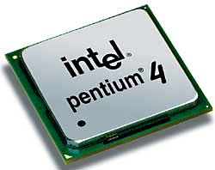
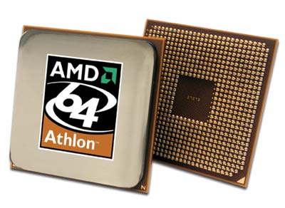
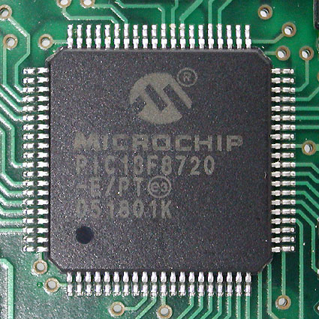
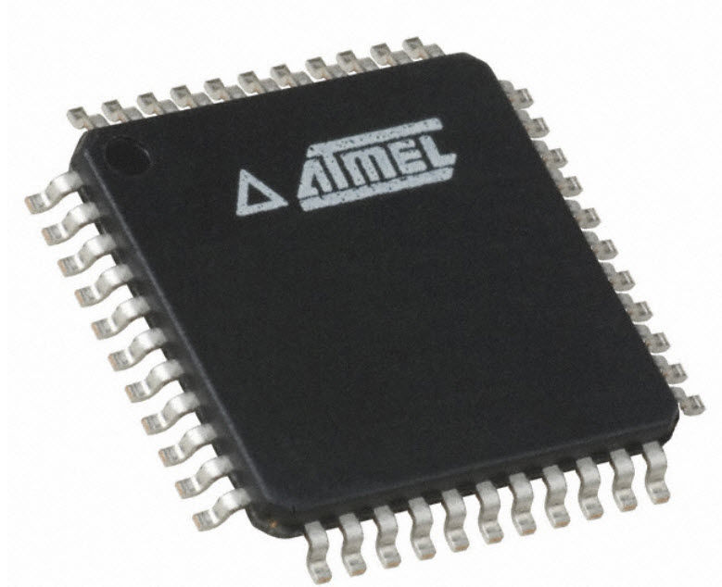
Microprocessors & Microcontrollers from different manufacturers
Atmel
Intel
National Semiconductor
Motorola
Texas Instruments
Zilog
Microchip

Slide 18
THANK YOU

